Slide 1


Jobnea
market place for ‘blue and grey collar’ jobs near me

Slide 2

Company – Social Venture
Our Understanding
Current Problem
Market Size
Business Model
Competitors
Marketing Plan
ABOUT JOBNEA

Slide 3

COMPANY, A SOCIAL VENTURE
Jobnea is a job market place for blue and gray collared jobs. Jobnea caters to the bottom-of-the-pyramid (BOP) informal sector workers (i.e. maids, cooks, drivers, etc.) with the goal to create a scalable, profitable and socially impactful solution.
How it works
Match & Hire → Easy Collaboration → Simple Payment
1
2
3

Slide 4
OUR UNDERSTANDING
C2C Mobile Application – simplified job matching service connecting jobseekers and employers
Two workflows – one for job seeker who will be called ‘local service provider’ and one for employer
Target consumer group – blue collar and grey collar jobseekers and employers
Technology Intervention to support job matching, delivery, payment and feedback
Require application for admin / super admin to manage the user profiles, feedback and payment operations
Require a free-call center
Require whatsapp integration for chat and alerts / notifications

Slide 5
CURRENT PROBLEM / OPPORTUNITY
‘Nobody was really looking into it until recently, and the problem is everywhere. We’d been thinking over it for a long time, and decided we should do it.’
Disconnect between workers and work in the informal / unorganized sector
Informal employment accounts for 84 percent of India’s non-agricultural employment and 21 percent of its GDP
Nearly half of India’s population is inactive or unemployed, and female labor force participation is extremely low
53 percent of Indian employers said that a lack of skills is a common reason for entry-level vacancies
By 2025, online talent platforms could raise India’s GDP by 1.9 percent ($222billion) annually creating 11.3 million full-time-equivalent positions
and nearly 77 million individuals could benefit in various ways, including shorter job searches, wider job options that result in better matches, and new ways to obtain contingent work
*Informal employment is defined as work in the informal sector (in enterprises that operate outside the view of tax authorities and regulators) or informal employment in the formal sector.

Slide 6


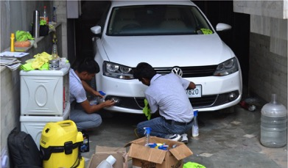
MARKET SIZE
The Local & home services industry in India is growing rapidly with about 69 startups founded in 2014 alone!
Local & Home Services Marketplaces
Local & Home services marketplaces segment is seeing large companies getting created globally. For instance the notable financing rounds from just Jan 2015
$100m Series D in Thumbstack by Google Ventures, Tiger Global, Sequoia Capital
$65m Series B in Porch
India Market Scenario
In India, though this segment has received limited venture, it caught our attention as over 70 of the 150 we had tracked in this segment were 2014 founded
Indicating this segment has been ripe for early stage funding in 2015
With 30 percent of India’s vast working-age population under the age of 24, India could reap a major demographic dividend. By 2030, it will have the largest working-age population in the world at one billion strong
Industry Buzz
Amazon foraying into local services marketplaces market – “Local Services is The New E-Commerce Battleground” (Forbes, Hindu BusinessLine)
• Thumbtack success story – “Thumbtack sent $1.8 billion worth of potential business to local firms in the U.S.” (Forbes)

Slide 7
BUSINESS MODEL
building a model which produces amazing work, zero headache and financial win-win to service providers and service seekers. Leverage crowd sourced funding methods.
1
INR100 as a ‘platform support’ fee per engagement (optional)
2
Hot Jobs Listing fee
3
Platform service fee for government programs
4
Enterprise services – Training & Education, Talent Sourcing and Onboarding

Slide 8
COMPETITORS
Competitors range from local service market places to home service providers. 69 startups founded in 2014 alone!
Localoye
FindYahan
GoodService
Babajob
Qyk
UrbanClap
Taskican
Aasaanjobs
Servicebasket
Doormint
Yelo
Nanojobs
Near
TaskBob
ServGenie
Quikrjobs
Zimmber
HouseJoy
MySahay
Servicesutra

Slide 9
MARKETING PLAN
Combined disruptive, experiential, OOH and online marketing techniques
Onboarding Jobseekers and Employers
Tie-up with National Career Service, State Departments for Employment Generation and Training, NSDC, SSCs (Sector Skill Councils), State Skill Missions / Government programs (aajevika, PMKY, etc) and ITIs / Vocational / Skill Training Institutes
Data collection through field force with tablets spread across 600 districts of India
Experiential (Engaging)
Promote through job fairs
Block / Village level programs engaging with local / community leaders
Out of Home (OOH)
Brand Ambassador
Paper ADs
Online
Press Releases / Advertorials
Blogging and using livelihood impact stories
Social Media (facebook, twitter, youtube, etc)

Slide 10

Understanding
System Overview
Our Approach – architecture, timeline
Resource Loading
Pricing
Assumptions
Project Communication
Proposal

Slide 11
WHO IS A LOCAL SERVICE PROVIDER
A Local Service Provider is one who provides services like plumbing, driving, carpentry etc. in your local area
A Service Provider who offers paid help
Part Time / Full Time / Hourly
Location and payment mode as mutually agreed with the service seeker
Service provider type include domestic help / care taker / baby sitter / beautician / carpenter / construction laborer / plumber / gardener / tailor / nurse / security guard, etc
Notes:
# 1, 2, 3, 4 points are about what makes a service provider

Slide 12







SYSTEM OVERVIEW
Mobile App Dashboard
Existing App Users*
Post / Update profile
Publish Job / Service Requirement
Publish availability calendar with bidding price
Real time map based tracking
Chat through whatsapp
Receive alerts / notifications (email and sms)
Post feedback
New Users*
Mobile Internet / Phone
Information Seekers
*Users - (Jobseekers and Employers)
Jobnea Monitoring Team
Service Providers
& Seekers
Activity
Service Requests
Responses
Analytics
Admin & Quality
Controls
Notes:
# How a Local Service Provider can access the services of the NCS ? – Through portal or Call Center. Not everything he/she could achieve through call center, we recommend Local Service Provider to frequently visit the portal to view jobs / internships, update service / area of specialization, availability profile.

Slide 13
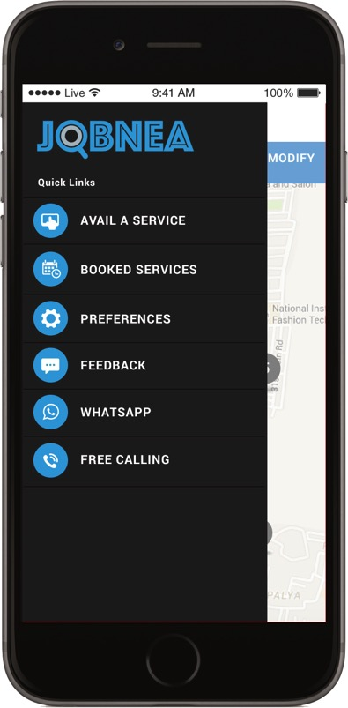
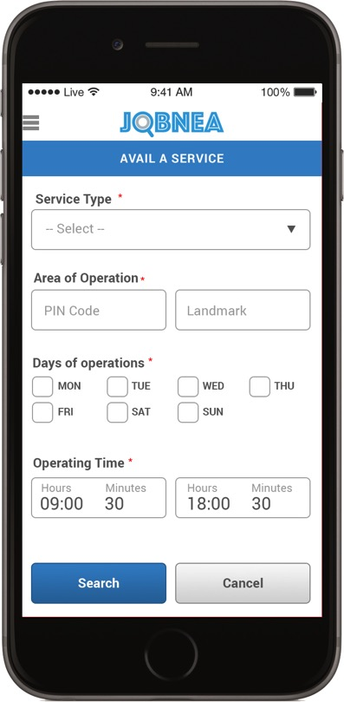


SAMPLE SCREENS
Flyout Menu to show various options for the service seeker (employer)
Avail a service to search for a particular service provider in a particular location
Notes:
1st – Service Seeker / Employer
Service Seeker – Search and Invite Service Provider
Post a requirement
NCS needs to be changed
Whatsapp integration ?
Free calling

Slide 14
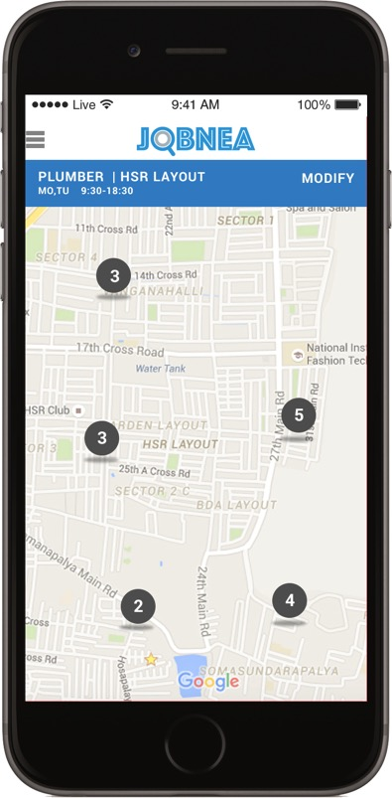
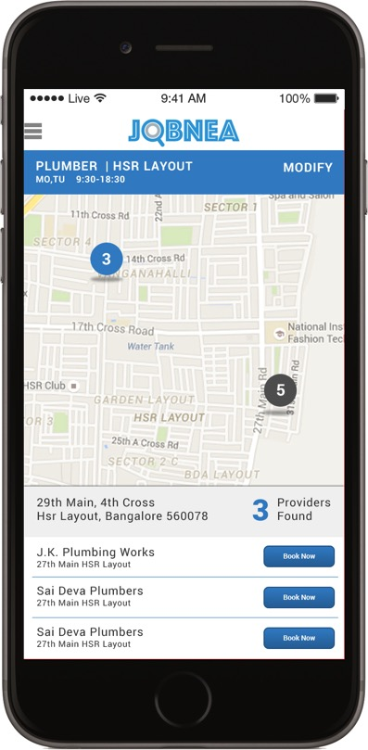
SAMPLE SCREENS
Map showing various numbers of service provider in a particular location based on the criteria given by the service seeker
Details of the service provider based on the choice and option to book for a service
Notes:
1st – Service Seeker / Employer
Service Seeker – Search and Invite Service Provider
Post a requirement
NCS needs to be changed
Whatsapp integration ?
Free calling

Slide 15
SOLUTION ARCHITECTURE
View
Jobnea
Mobile App
S
E
R
V
E
R
Controller
Controller
JSON
Payment Gateway
Internet / Local Network
N/W Manager
Local DB
SQL DB
HTTPS Request/Response

Slide 16
ASSUMPTIONS
1
Application will be deployed to end user mobile phone through app store.
2
Mobile Application will be tested only in 5 models of android devices
3
Portal will have support for IE , Mozilla and Chrome. However testing will be done only for chrome
4
Application Signing certificates will be provided by customer
5
Supports English and Hindi

Slide 17
PROJECT COMMUNICATION
Release Reports.
Review Meetings – Weekly, Monthly (Mgmt Meeting)
Release Readiness Review Meeting
Weekly Status Report.

Slide 18
THANK YOU

